Slide 1
Covid-19 Vaccine Reaction Analysis
Analyzing & evaluating risk factors using adverse events based on age & gender to predict life-threatening risk probability of receiving a COVID-19 vaccine.

Slide 2
BACKGROUND & TOPIC SELECTION
US Citizens are concerned about the risk factors of taking the COVID-19 vaccines. We are playing the role of a team of data scientists hired by the government to analyze and assess the risk factors of receiving one of the three Emergency-Use Authorized COVID-19 vaccines.
What is VAERS?
How VAERS Reporting System help CDC & FDA?
Why did we chose this vaccine analysis?
The outcome of the analysis is to help citizens make a more informed decision when taking the vaccine. We will use vaccine adverse event data provided by the government from the Vaccine Adverse Event Reporting System. We will analyze and assess risk factors of taking the COVID19 vaccine.

Slide 3
TECHNOLOGIES AND RESOURCES
PostgresSQL
Python
Pandas Library
Scikit-Learn Library - Machine Learning
Tableau Public

Slide 4
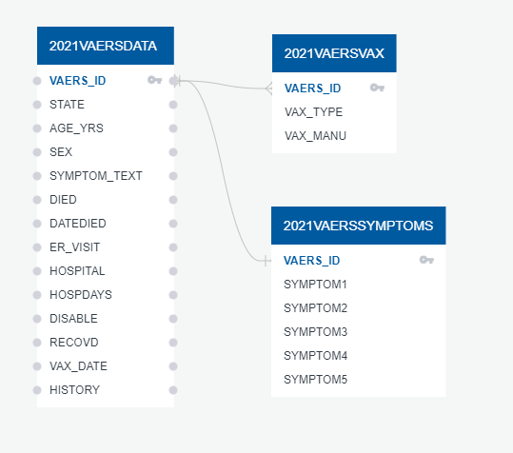
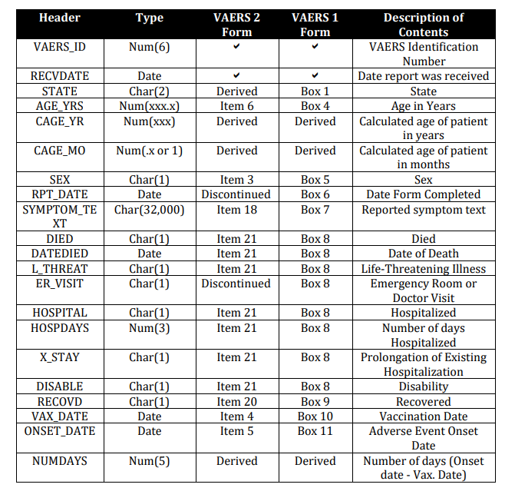
DATA STRUCTURE & USER GUIDE

Slide 5
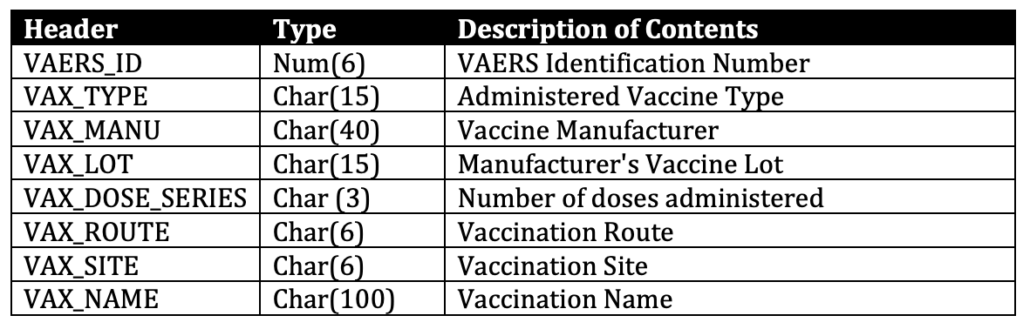
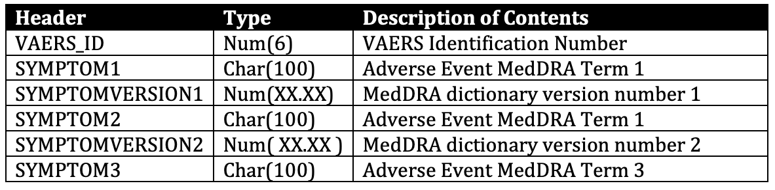
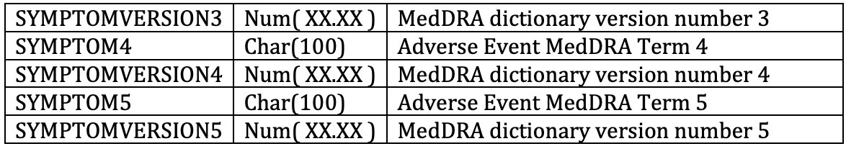
DATA STRUCTURE & USER GUIDE

Slide 6
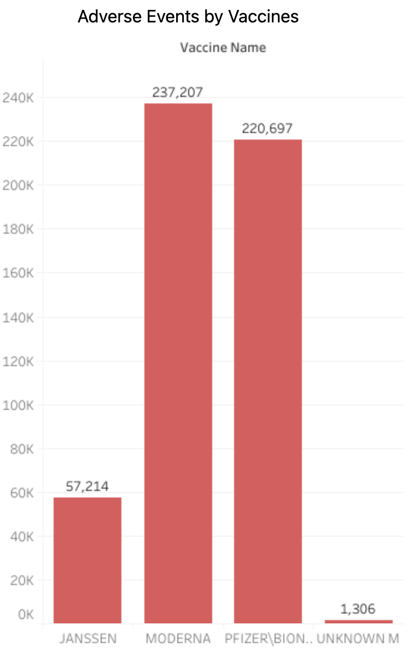
TABLEAU COVID-19 VAERS ANALYSIS
Created a page to display the most frequent symptoms that were reported with life threatening risks.
Total number of adverse events by vaccines.
Most frequent symptoms reported by gender
Most frequent hospitalizations reported by gender
Total number of adverse events for ER visits, hospitalizations, life threatening events.

Slide 7
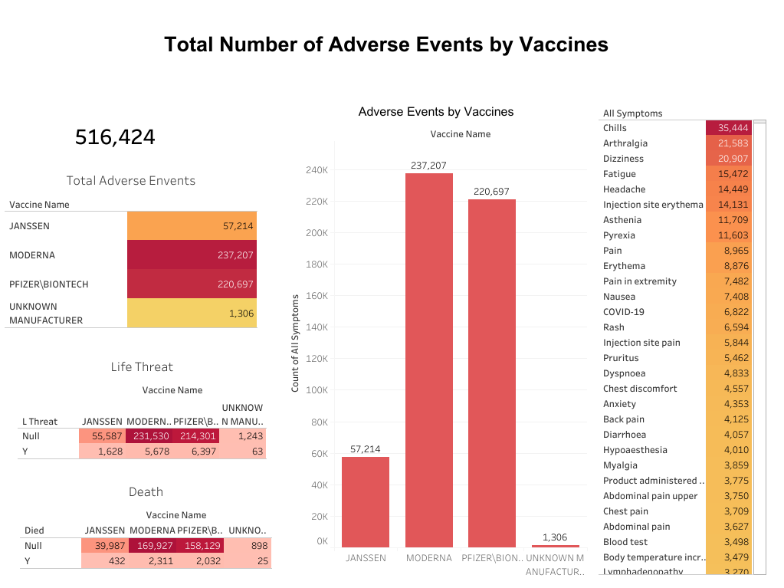
TABLEAU COVID-19 VAERS ANALYSIS
Created a page to display the most frequent symptoms that were reported with life threatening risks.
Total number of adverse events by vaccines.
Most frequent symptoms reported by gender
Most frequent hospitalizations reported by gender
Total number of adverse events for ER visits, hospitalizations, life threatening events.

Slide 8
Can we predict the probability of a person over the age of 60 receiving a life threatening symptom?
From analyzing our data, we found a spike of life threatening symptoms in older patients. Using python’s pandas and scikit-learn libraries, we can seek out the answer to our prediction.

Slide 9
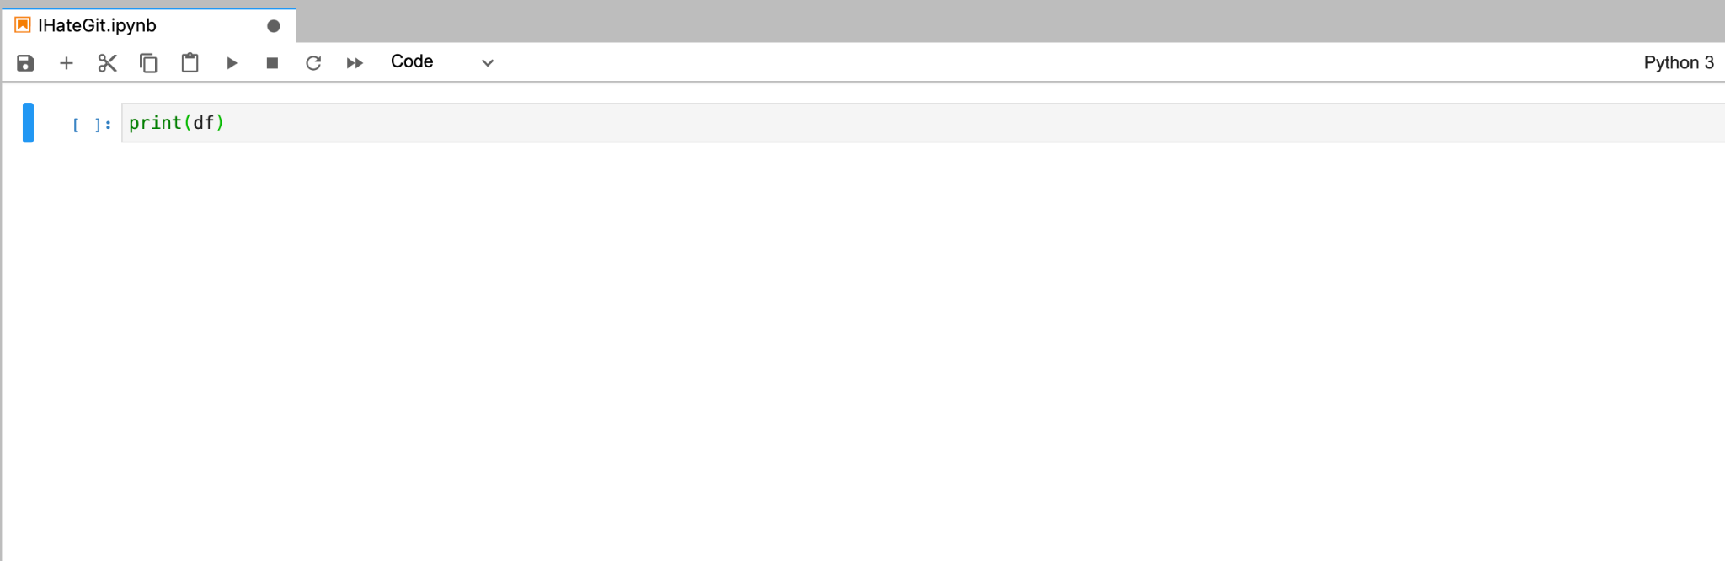
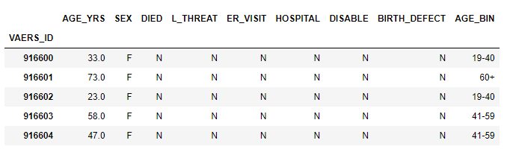
CLEANING DATA USING PYTHON
For the 2021 VAERS Data file:
Dropped the unnecessary columns.
Replaced null values several columns to “N” to be fed into the machine learning.
Null values on the age column were replaced with the median age for the provided gender.
We created bins for ages to group them for the machine learning.

Slide 10
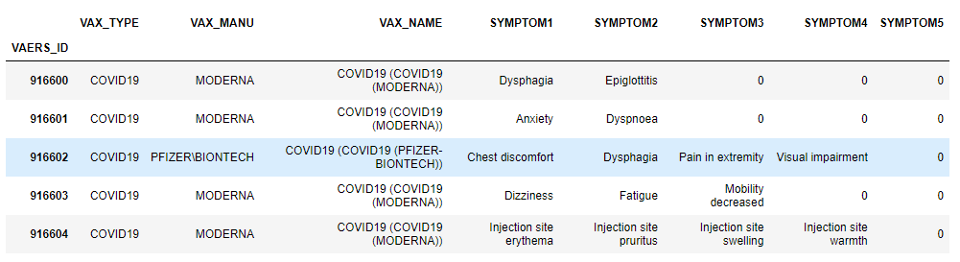
CLEANING DATA USING PYTHON
For the 2021 VAERS VAX file:
Kept the columns with vaccine name and type in order to set as an unique ID and filter for COVID-19 adverse events only.
For the 2021 VAERS SYMPTOMS file:
We grouped the values of each of the symptom columns to remove the multiple rows for those IDs that had more than 5 symptoms.

Slide 11
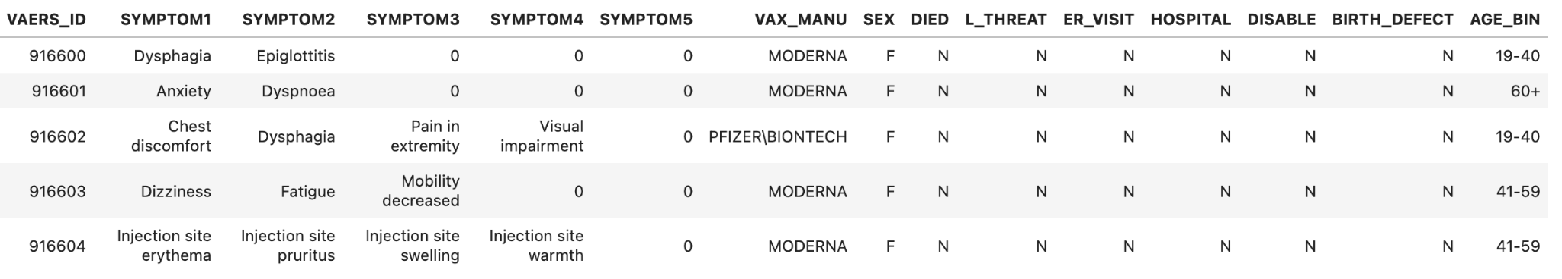
CLEANING DATA USING PYTHON
We merged the Vax dataframe with the Symptoms dataframe.
Filtered for COVID-19 vaccine type only.
Finally, the Data dataframe was merged with the Vax and Symptoms dataframe and it was exported to be used on the machine learning model.

Slide 12
CLEANING DATA USING PYTHON
To find which symptoms had the most life threatening, we had to filter down the dataset by hospitalization, life threatening, and death
We took the remaining symptoms from all 5 columns and listed out the most frequent symptoms.
Finally, we have created a dataset that contains all ID’s with only the most life threatening symptoms.
The data frame is now ready for our machine learning model

Slide 13
MACHINE LEARNING IN PYTHON
IMPORT
We imported the cleaned data file for our machine learning

Slide 14
MACHINE LEARNING IN PYTHON
IMPORT
CONVERT
We imported the cleaned data file for our machine learning
Next, we converted the symptom list into unique numbers and the rest of the categorical features into a binary column

Slide 15
MACHINE LEARNING IN PYTHON
IMPORT
CONVERT
TRAIN AND TEST
We imported the cleaned data file for our machine learning.
Next, we converted the symptom list into unique numbers and the rest of the categorical features into a binary column.
The dataframe needed to be split into random train and test subsets, then scaled to unit variance.

Slide 16
MACHINE LEARNING IN PYTHON
IMPORT
CONVERT
TRAIN AND TEST
PREDICT
We imported the cleaned data file for our machine learning.
Next, we converted the symptom list into unique numbers and the rest of the categorical features into a binary column.
The dataframe needed to be split into random train and test subsets, then scaled to unit variance.
Using RandomForestClassifier, we were able to achieve a predictive accuracy with controlled over-fitting.

Slide 17
72%
Chance to get a symptom that was present during a life threatening adverse event if you are over the age of 60

Slide 18
Conclusion
Despite the heightened chance to get a life threatening symptom over the age of 60, our initial data found the death rate to be low. Even for the deaths reported, we lack the current resources to take pre-existing conditions into account. VAERS reports new data everyday, leaving more potential for unique questions to be asked, and more precise predictions to be answered.

